Slide 1


Environmental monitoring

Slide 2
Introduction
Pollution monitoring refers to the quantitative or qualitative measure of the presence, effect, or level of any polluting substance in a defined environment (air, water, or soil).
Environmental monitoring is a tool to assess environmental conditions and trends, support policy development and its implementation, and develop information for reporting to national policymakers, international forums and the public.
describes the processes and activities that need to take place to characterize and monitor the quality of the environment. Environmental monitoring is used in the preparation of environmental impact assessments, as well as in many circumstances in which human activities carry a risk of harmful effects on the natural environment.

Slide 3
.....
All monitoring strategies and programs have reasons and justifications which are often designed to establish the current status of an environment or to establish trends in environmental parameters. In all cases, the results of monitoring will be reviewed, analyzed statistically, and published. The design of a monitoring program must therefore have regard to the final use of the data before monitoring starts.
Environmental monitoring includes monitoring of air quality, soils and water quality.

Slide 4
....
I can give you an induction on environmental monitoring! Environmental monitoring is the process of collecting data about the environment to assess its quality and make informed decisions. It involves using sensors to measure various parameters such as air quality, water quality, temperature, and humidity. The collected data is then analyzed to identify any potential issues or trends. This information helps in understanding the current state of the environment and taking necessary actions to protect and improve it. Let me know if you have any specific questions or if there's anything else I can assist you with.

Slide 5
Project objectives
Define objectives such as real-time environmental monitoring, aiding park visitors in activity planning, promoting outdoor experiences, and enhancing visitor satisfaction.
IoT Devices Designs: Plan the deployment of IoT sensors (e.g., temperature and humidity sensors) in public parks.
Environmental Monitoring Platform: Design a web-based platform to display real time environmental data to the public.
Integration Approach: Determine how IoT devices will send data to the environmental monitoring platform.

Slide 6
Temperature monitoring
Introduction:
Temperature is a physical quantity that expresses quantitatively the attribute of hotness or coldness. Temperature is measured with a thermometer. It relects the kinetic energy of the vibrating and colliding atoms making up a substance.
Thermometers are calibrated in various temperature scales that historically have relied on various reference points and thermometric substances for definition.

Slide 7
....
The most common scales are the Celsius scale with the unit symbol °C (formerly called centigrade), the Fahrenheit scale (°F), and the Kelvin scale (K), the latter being used predominantly for scientific purposes. The kelvin is one of the seven base units in the Internation

Slide 8
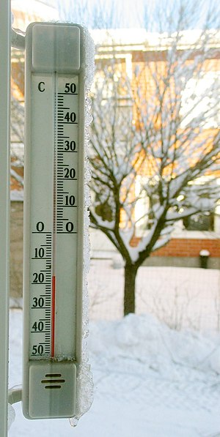
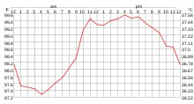
....

Slide 9
Humidity monitoring
Humidity is the concentration of water vapor present in the air. Water vapor, the gaseous state of water, is generally invisible to the human eye.Humidity indicates the likelihood for precipitation, dew, or fog to be present.Humidity depends on the temperature and pressure of the system of interest. The same amount of water vapor results in higher relative humidity in cool air than warm air. A related parameter is the dew point. The amount of water vapor needed to achieve saturation increases as the temperature increases.

Slide 10
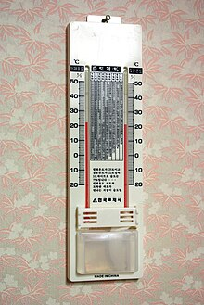
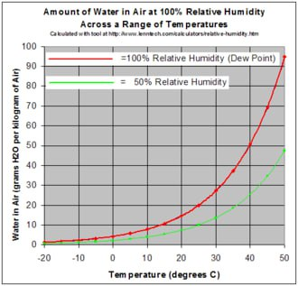
Diagram of humidity monitoring

Slide 11
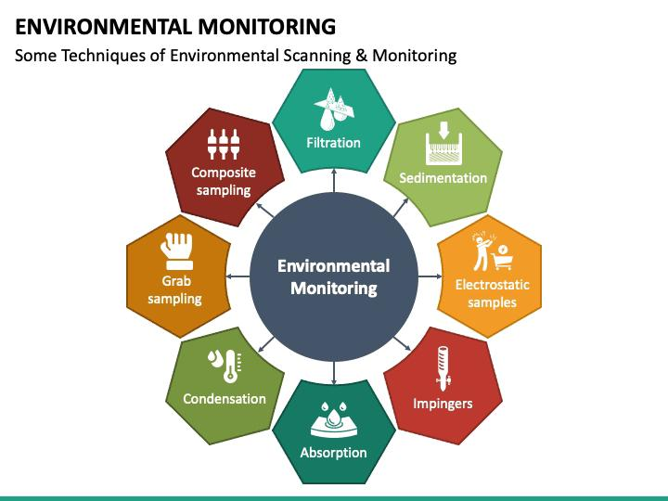
Pie chart

Slide 12
Program
Humidity:
#include <dht11.h> #define DHT11PIN 4 dht11 Dhsetu; void setup() { Serial.begin(9600); } void loop() {

Slide 13
...
Serial.println(); int chk = DHT11.read(DHT11PIN); Serial.print(“Humidity (%): “); Serial.println((float)DHT11.humidity, 2);
Serial.print("Temperature (C): ");
Serial.println((float)DHT11.temperature, 2);
delay(2000);
}

Slide 14
Temperature program
float temp;
int tempPin = 0;
void setup() {
Serial.begin(9600);
}
void loop() {
temp = analogRead(tempPin);
temp = temp * 0.48828125;
Serial.print("TEMPERATURE = ");
Serial.print(temp);

Slide 15
.....
temperature value
Serial.print("*C");
Serial.println();
delay(1000);

Slide 16
C program of environmental monitoring
#include <DHT.h>
#define DHTPIN 4
#define DHTTYPE DHT22
DHT dht(DHTPIN, DHTTYPE);
void setup() {
Serial.begin(115200);
dht.begin();
}
void loop() {
delay(2000);

Slide 17
....
float temperature = dht.readTemperature();
float humidity = dht.readHumidity();
("40 %"); }}
if (isnan(temperature) || isnan(humidity)) {
Serial.println("Failed to read from DHT sensor!");
} else {
Serial.print("Temperature: ");
Serial.print(temperature);
Serial.println(" 24°C");
Serial.print("Humidity: ");
Serial.print(humidity);
Serial.println(“40 %”) ;
}

Slide 18
Python program
#include <stdio.h>
#include <stdlib.h>
#include <time.h>
double readEnvironmentalData() {
return 25.5;
}
int main() {
FILE *file;
char filename[] = “environmental_data.log”;
file = fopen(filename, “a”);

Slide 19
.....
if (file == NULL) {
printf(“Error opening the file.\n”);
return 1;
}
time_t rawtime;
struct tm *timeinfo;
time(&rawtime);
timeinfo = localtime(&rawtime);
double environmentalData = readEnvironmentalData();
fprintf(file, “Timestamp: %s”, asctime(timeinfo));
fprintf(file, “Environmental Data: %lf\n”, environmentalData);
fclose(file);
return 0;
}

Slide 20
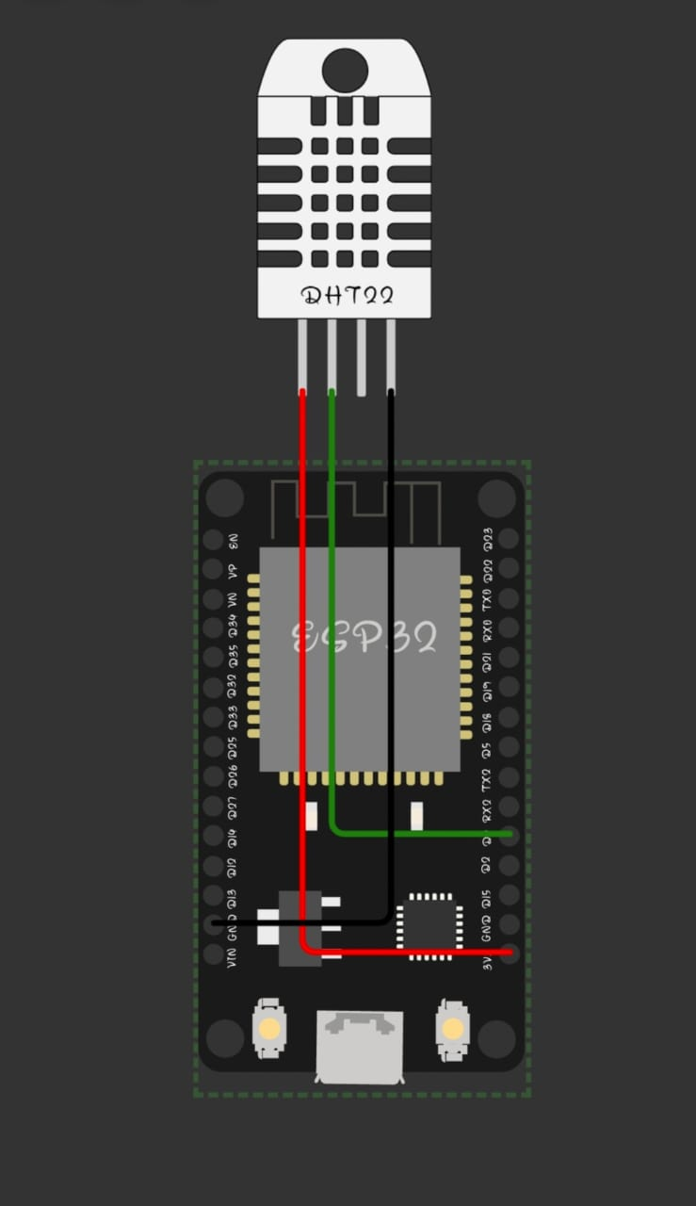
Simulation of project

Slide 21
Works
The ESP32 is a microcontroller that works by executing instructions and processing data. It has a dual-core processor, which means it has two separate processing units that can work simultaneously. This allows for better multitasking and improved performance. The ESP32 also has built-in Wi-Fi and Bluetooth capabilities, making it easy to connect to the internet and communicate with other devices. It’s commonly used in IoT projects to enable wireless connectivity and control. To simulate environmental monitoring, you would create a program that collects data from sensors placed in the environment. This data can include temperature, humidity, air quality, and more. The program would periodically read the sensor values and store them for analysis. You can then use this data to monitor and analyze environmental conditions over time,

Slide 22
.....
identify trends, and make informed decisions based on the data collected. It's a great way to gain insights and take proactive measures to maintain a healthy and sustainable environment.
The environmental monitoring system based on wireless sensor network technology is an online monitoring and management support system. Whether the system works normally or not is directly related to the evaluation of monitoring performance and the online diagnosis of equipment working state.

Slide 23
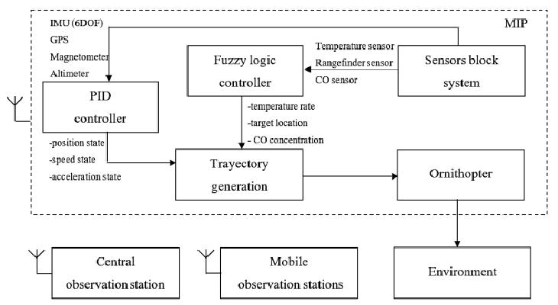
Flow chart of project

Slide 24
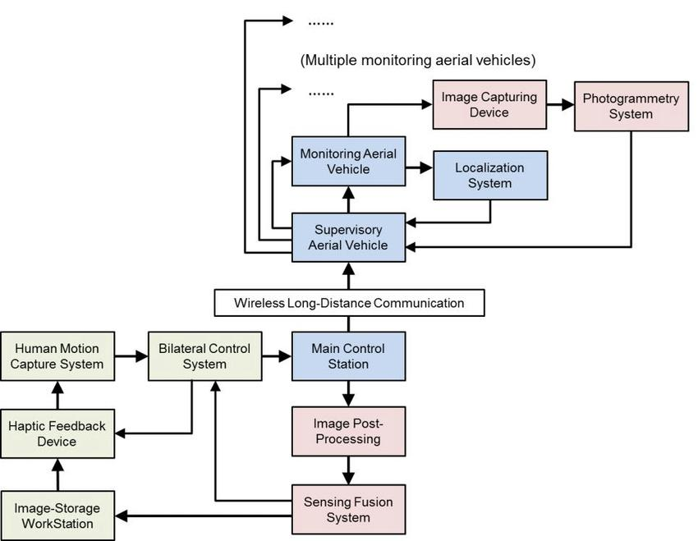
Flow graph of working

Slide 25
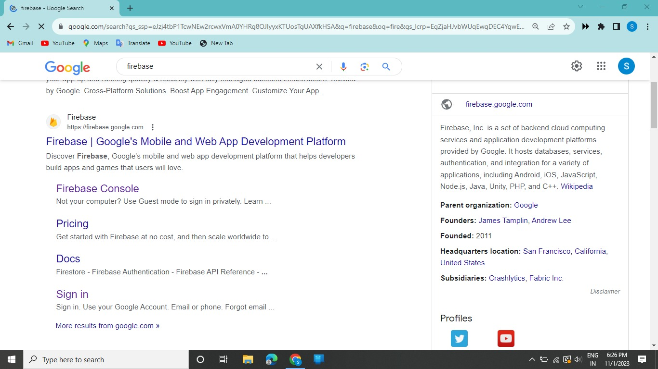
Firebase console

Slide 26
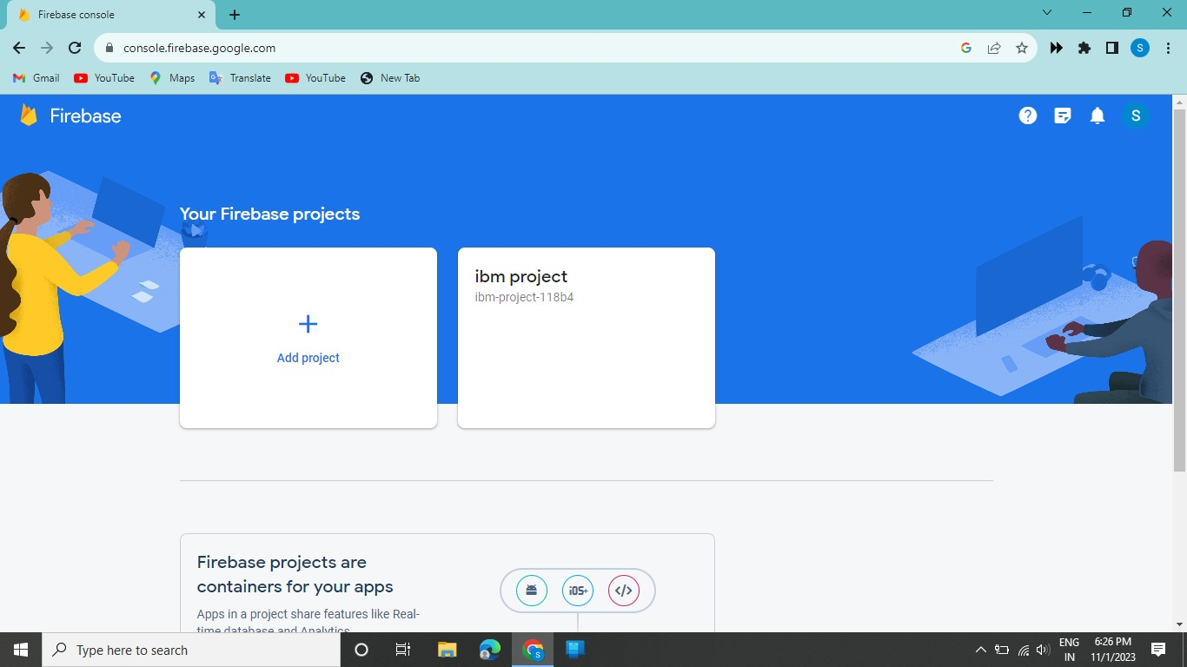
.....

Slide 27
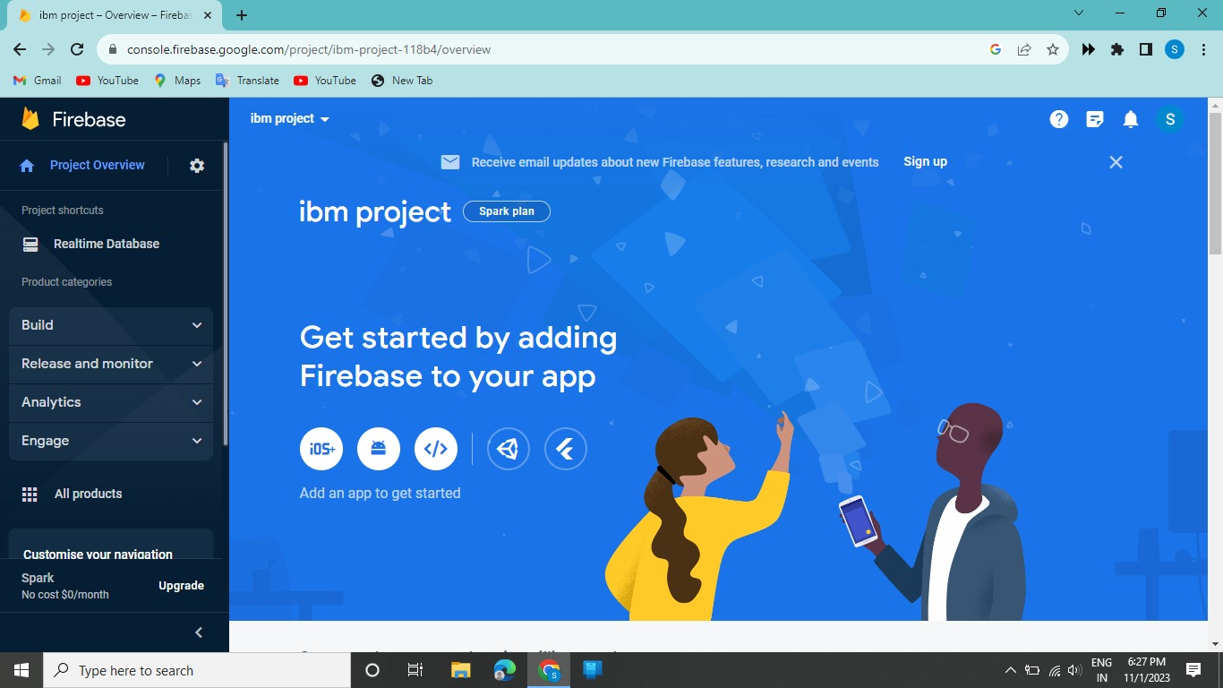
....

Slide 28
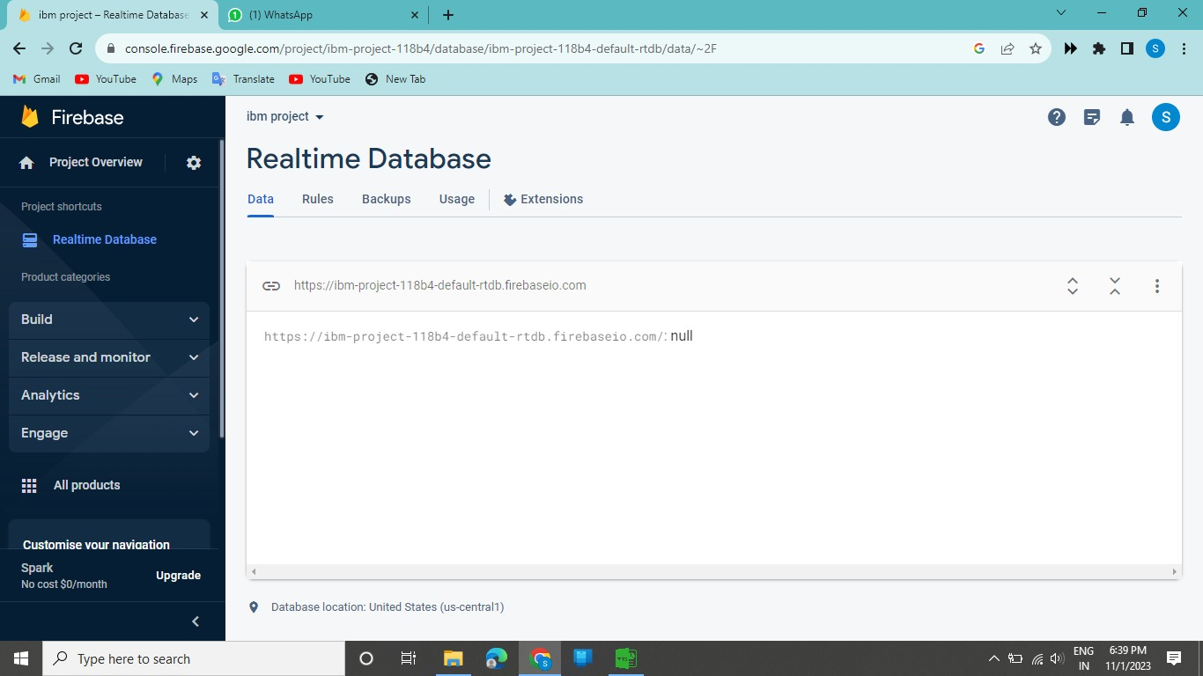
....

Slide 29
Steps of firebase
Search firebase console in any search engine
Then tap firebase console
Then add new project
Then click your project
Then click realtime database
Then select database location
Then enter your wokwi coding
Then run the program

Slide 30
Related work
I can help you with environmental monitoring-related work! Environmental monitoring involves collecting data about the environment to assess its quality and make informed decisions. This can include monitoring air quality, water quality, temperature, humidity, and more. By using sensors and data analysis techniques, you can gather valuable insights to understand and improve environmental conditions. Let me know if you have any specific questions or if there’s anything else I can assist you with.

Slide 31
Conclusion
Based on the information you provided, the working principle of the ESP32 microcontroller involves its ability to monitor and simulate environmental conditions. It can collect data from various sensors and simulate different scenarios for environmental monitoring. Let me know if you'd like more details.

Slide 32

.....

